Slide 1
Finding best place for a new coffee shop in Vienna, Austria

Slide 2
Introduction

Slide 3
Background
Vienna’s very first coffee house opened in 1683. Even if Vienna was not the pioneer in coffee house culture, it has - over the centuries - established a coffee house tradition like no other city in the world. Coffee and coffee houses are at their best in Vienna!
Problem
Since so many coffee houses can be already found in any district in Vienna it would be good to know if there is a strong correlation between the presence of coffee houses in the vicinity of sightseeing places or any other venues like offices or shopping malls. It can be assumed that those places are highly frequented. This is a relevant key-indicator to be considered in order to have a profitable business. Furthermore the question for a reasonable rent comes up in order to find the ideal spot for the coffee house. So two main criterias need to be met: area of interest (representing high frequency of passers-by) low rental fee
Interest
These questions could be of high interest for any new investor or entrepreneur who wants to open one or maybe even more coffee houses in Austria’s capital. This project can also be part of business analytics for larger companies who consider expanding their business.

Slide 4
Data acquisition and cleaning
Data sources
For this project the following data is going to be used to gain insight and answer the questions:
Datasource:
Foursquare API: "https://developer.foursquare.com/"
Purpose:
Get Top 10 common venues in each neighborhood (coffee houses, sightseeing spots, malls etc.)
Datasource:
Vienna rent statistics: “https://www.immopreise.at/Wien/Wohnung/Miete”
Purpose:
For practice purposes this data is only going to represent a rough overview of mean rent in each district from this year. This should be sufficient in the beginning. Since a proper dataset for the rent prices doesn't exist, it must be scraped from 'Immopreise'.

Slide 5
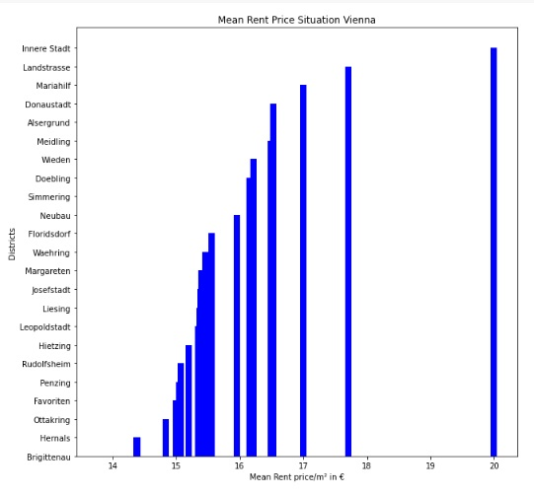
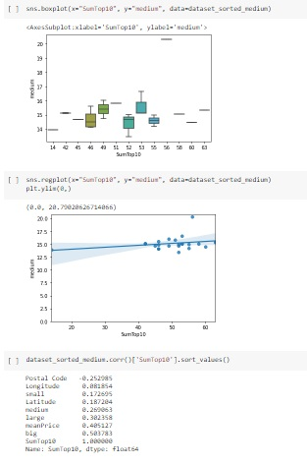
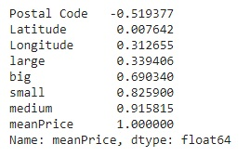
Exploratory Data Analysis
Visualizing mean rent price situation in Vienna
Explore Neighborhoods
Find Top 10 common Venues
Find Correlations

Slide 6
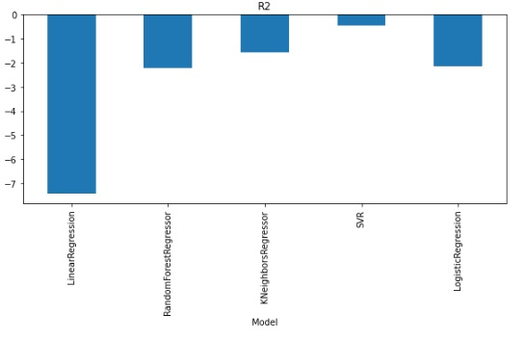
Predicting best model
Support Vector Model?

Slide 7
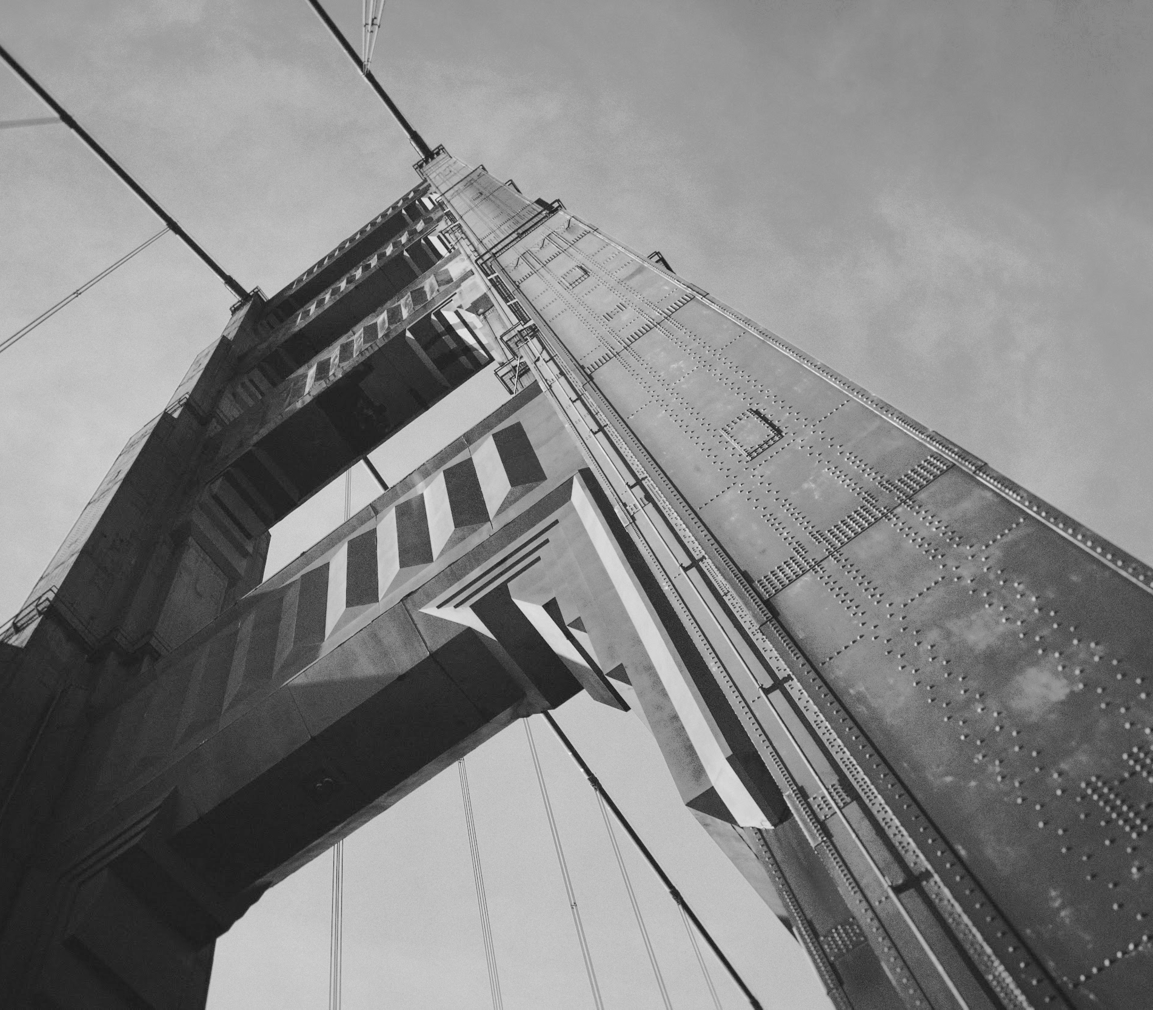
Conclusion
Built models inaccurate
Accuracy of the models has room for improvement
Ideas include:
larger datasets
new features e.g.
tourist-frequency, passers-by…
‘Floridsdorf’ seems to be a good spot for a new coffee house

